Slide 1
YOUR
JABIL STORY

Slide 2
THIS WORKSHOP WILL HELP YOU DISCOVER YOUR PERSONAL CONNECTION TO JABIL, AND HOW
YOUR WORK ALIGNS WITH THE MISSION & VISION OF THE COMPANY
TOGETHER, WE WILL CREATE
YOUR JABIL STORY.

Slide 3
WHY?
Simplify messaging
to help all of us
talk about the company in
plain language
Connect us to
the Jabil brand
in a way that is
relevant and meaningful
Empower
all of us
to serve as ambassadors
for Jabil

Slide 4
WHAT’S YOUR JABIL STORY?
WE ARE ALL CONNECTED
TO THE COMPANY AND EACH OTHER
The following exercises will help you discover:
How you
connect to
Jabil
Where your piece of the puzzle fits
How your work reflects Jabil’s mission and vision

Slide 5
OUR DIFFERENTIATORS
SOLUTIONS
INGENUITY
INTELLIGENCE
Enabling Each Customer’s Success
Proactive Innovation From Empowered Experts
Analytics in Action to Lead in a Digital World
CREDIBILITY
IMPACT
OPPORTUNITY
Trusted, Experienced Partners Who Do the Right Thing
Driven by a Common Purpose to Make a Difference
Everyone’s Voice
is Heard

Slide 6
EXAMPLE
“CREDIBILITY is really important to me, because if my customers trust me to tell the truth - even when it’s uncomfortable – we’re much more likely to build a long-term relationship. People need to believe that I’m working FOR them and WITH them. They trust me to know what will help them succeed."
“I work in HR, so I try to ensure that OPPORTUNITIES at Jabil are available to everyone who wants to grow their career, not just a few hand-picked group of people.”

Slide 7
OUR DIFFERENTIATORS
SOLUTIONS
INGENUITY
INTELLIGENCE
Enabling Each Customer’s Success
Proactive Innovation From Empowered Experts
Analytics in Action to Lead in a Digital World
CREDIBILITY
IMPACT
OPPORTUNITY
Trusted, Experienced Partners Who Do the Right Thing
Driven by a Common Purpose to Make a Difference
Everyone’s Voice
is Heard

Slide 8
YOUR EXPERIENCES AT JABIL
Describe a time when it felt like you were meant to be here.
What is the best thing that has happened at work?
What is the biggest crisis you’ve faced at work?
How was it addressed and solved?
How did your team help you deal with a challenge?
What is one thing that you do every day that demonstrates the DIFFERENTIATORS?

Slide 9
EXAMPLE
Describe a time when it felt like you were meant to be here.
I’m a relatively new employee here, so it can be a little overwhelming at times. It can take a lot of time to build trust with people in other functions. I remember the first time someone called me for help resolving a complex issue, and I realized I actually knew exactly what to do!
What is one thing that you do every day that demonstrates company values?
It’s really important to me to be available and responsive. I know how hard it is to finish a project when I’m depending on someone else to respond to an email or answer a question. Responsiveness is a huge part of our culture, whether it’s helping a customer or a teammate to succeed.”

Slide 10
YOUR EXPERIENCES AT JABIL
Describe a time when it felt like you were meant to be here.
What is the best thing that has happened at work?
What is the biggest crisis you’ve faced at work?
How was it addressed and solved?
How did your team help you deal with a challenge?
What is one thing that you do every day that demonstrates the DIFFERENTIATORS??

Slide 11






OUR TAGLINE
HOW DOES YOUR WORK MAKE
ANYTHING POSSIBLE AND
EVERYTHING BETTER?

Slide 12
EXAMPLE
How does your work make ANYTHING POSSIBLE and EVERYTHING BETTER?
I listen.
I help people figure out how to get their idea out of their head and into a design.
I create new processes that save our site time and money.

Slide 13
OUR TAGLINE
HOW DOES YOUR WORK MAKE
ANYTHING POSSIBLE AND
EVERYTHING BETTER?
Notes:
Welcome back! Who would like to tell us what they wrote here?

Slide 14
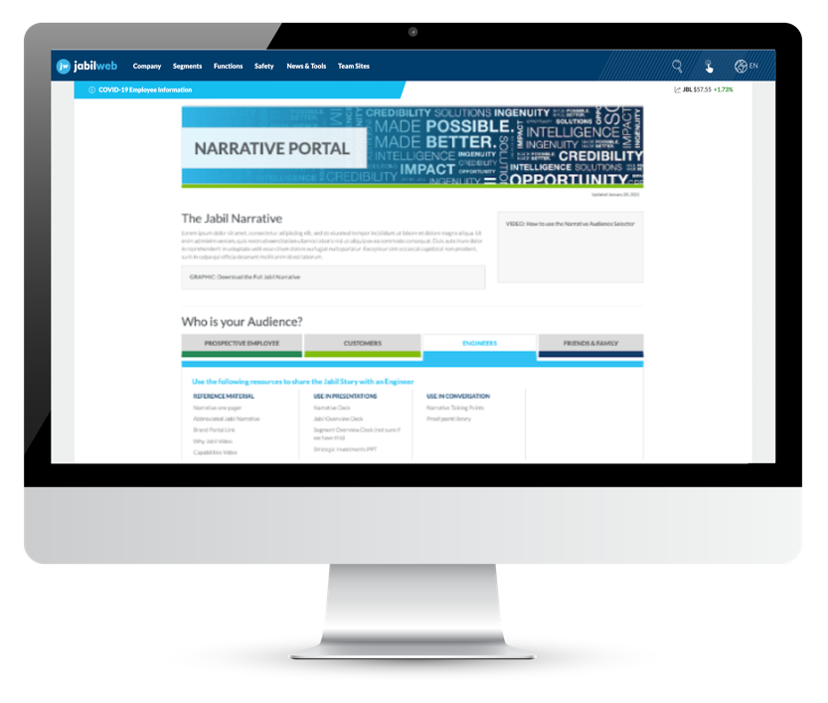
NARRATIVE PORTAL
The Narrative Portal is designed to help you tell YOUR Jabil story for different audiences.
Prospective Employees
Customers
Engineers
Friends & Family
NARRATIVE PORTAL DEMO

Slide 15

THE STORY
YOUR
JABIL STORY
JABIL’S
STORY
NARRATIVE
PORTAL
YOUR
WORK
YOUR
EXPERIENCES

Slide 16
EXAMPLE – YOUR STORY
I’m a Talent Acquisition Manager – I’ve worked at Jabil for 10 years. I actually started in Operations. I transitioned to TA about three years ago when I realized how much I loved helping people grow their career.
People might think a company like Jabil is too big to care about one person’s professional development, so I show prospective employees that OPPORTUNITIES are endless here. I listen to what’s important to them, and they trust me to help them find a role here that’s challenging and that will allow them to grow with the company.
We thrive in an entrepreneurial culture where talented people can do their best work. We work together in a way that enables us to be our best selves; it challenges us and encourages us. I wouldn’t have the job I do without that encouragement.
Life at Jabil is unique, and it’s what distinguishes us from other companies. Extensive training programs are a fundamental element of a career with us. The world around us changes so fast, and we believe in leading with knowledge. Continuous improvement is one of our core values. As a lean six sigma organization, we rely on a collaborative team effort to improve performance by systematically solving inefficiencies and getting smarter, and better in everything we do.
I can be myself here because we take care of people and respect each other. We get involved in our communities around the world, and we make a difference. We’ve created a culture where everyone can explore opportunities and succeed without having to compromise who they are.
A lot of people at Jabil helped me find my passion, and now I get to pay it forward.
WE MAKE OPPORTUNITY POSSIBLE.
Notes:
Here’s an example of what YOUR story might look like -

Slide 17
YOUR INTRODUCTION
USING THE EXERCISES IN THIS WORKSHOP, CRAFT YOUR OWN INTRODUCTION.
How will you introduce yourself to:
A customer
A potential or new employee
A colleague from another segment or function
Consider:
YOUR WORK + YOUR EXPERIENCES + YOUR CONNECTION TO JABIL

Slide 18
EXAMPLE
YOUR INTRODUCTION
I’m a Talent Acquisition Manager – I’ve worked at Jabil for 10 years. I actually started in Operations. I transitioned to TA about three years ago when I realized how much I loved helping people grow their career.
I remember how much it meant to me that people at Jabil helped me find my passion, and now I get to pay it forward.
People might think a company like Jabil is too big to care about one person’s professional development, so I show prospective employees that OPPORTUNITIES are endless here. I listen to what’s important to them, and I work really hard to help them find a role here that’s challenging and that will allow them to grow with the company.
Notes:
Here’s an example of what that might look like -

Slide 19
Notes:
Thank you for your time today! You’re helping us road test this workshop, so your feedback is important. You’ll receive a survey – please let us know your thoughts about this workshop. What worked and what didn’t. You’re welcome to reach out to me directly if you have questions or ideas for ways we can improve.

